Slide 1
JPOS Artist Information Session
Jamaica Plain Open Studios 2024
Saturday and Sunday, September 28 and 29, 2024
Wednesday, May 8th, 7pm via Zoom
Topic: JPOS 2024 Artist Information Session

Slide 2
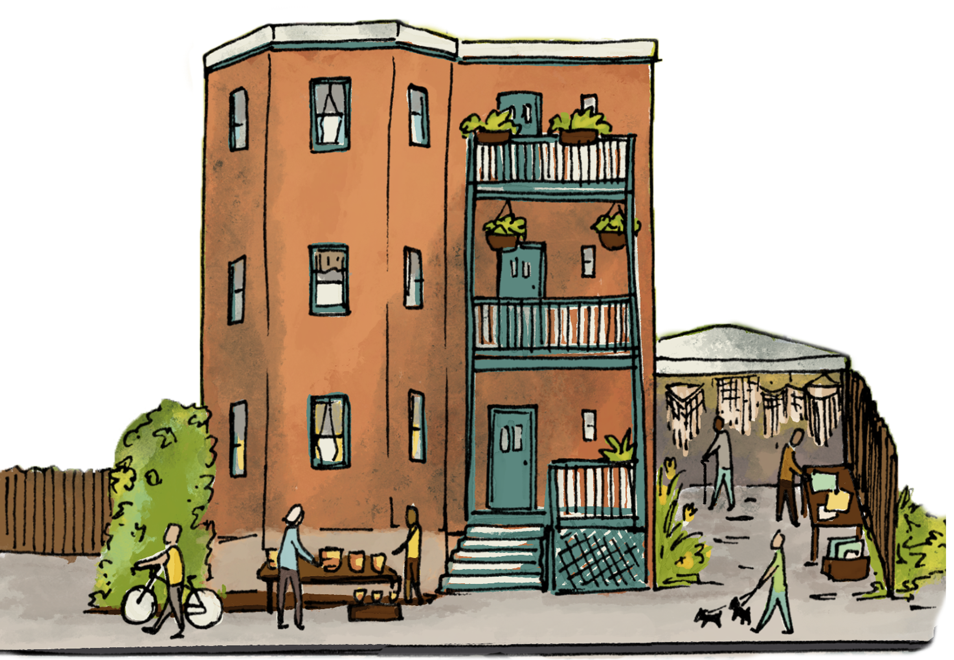
Agenda
JPOS Hours for 2024
JPOS Group Site for 2024
Business, Private and Shared Spaces
Registration Process
What’s included in my registration
Website and Artist Gallery
Artist of JPOS campaign
Map(s) and Materials
Free Workshops
Volunteer Opportunities
Questions

Slide 3
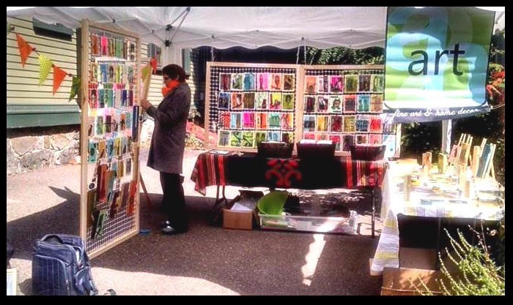
JPOS Hours for 2024
Overall event hours will be 11am – 6pm both Saturday and Sunday
Notes:
We understand this change may generate concerns, and appreciate artists’ and the community’s understanding and cooperation.
Looking forward to a vibrant event with the involvement of many community partners who generously share their space and time with us.

Slide 4
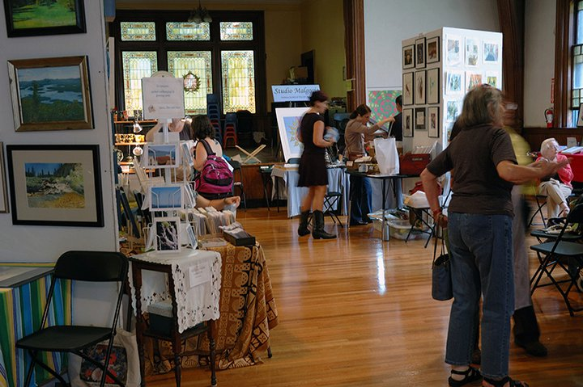
2024 JPOS Group Sites
Loring-Greenough House (outside) = 13 spaces
First Baptist Church (outside) = 16 spaces
Curtis Hall - new group site last year = 12 outdoor spots
First Unitarian Universalist Church (outside) = 15 spaces
(inside) 8 table and 15 panel spaces
When registering for a group site, please be prepared to select your ideal location and provide your registration payment (payment must be made by credit card).
Group sites will be filled on a first come-first placed basis.
Registrants can only complete one registration at a time after which they will need log out to restart the registration process for any additional registrant(s).

Slide 5
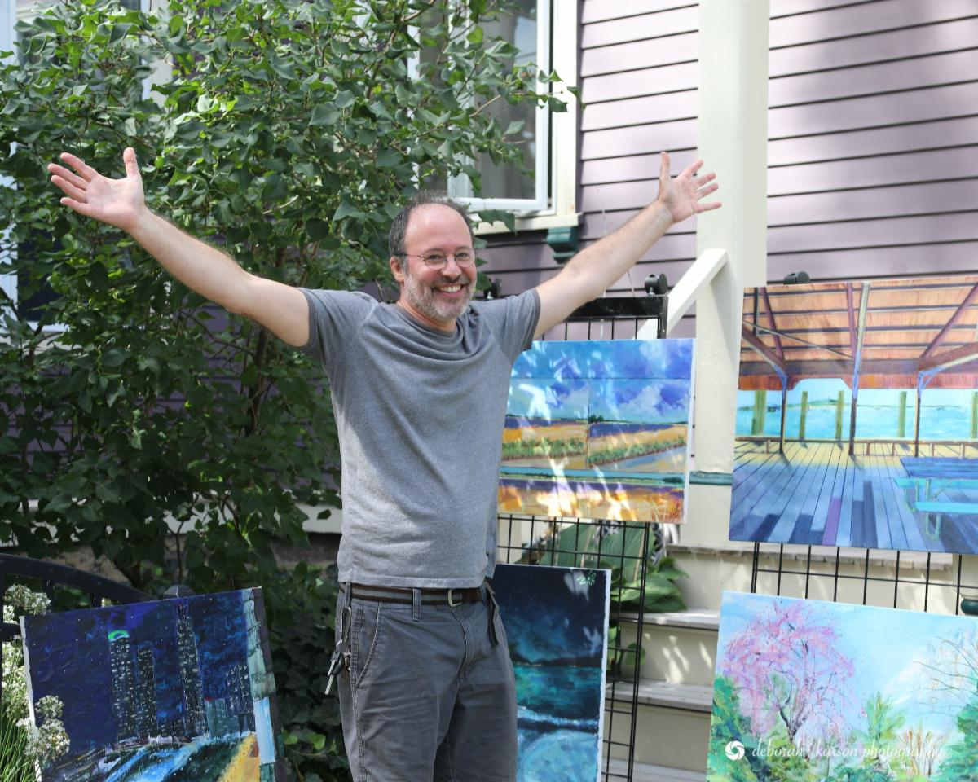
Business/Private/Individual Studio Registration: spaces unlimited
Individual Studio, Shared Studios, Private Shared Site and Local Businesses
Artist showing in private spaces as still required to register.
If the business location you are showing at is also a JPOS sponsor, you still need to register. Sponsorship does not cover an artist’s registration. If you do not register you will not be listed on the map.
Please contact us if you are looking to either open up your outdoor space to a fellow artist or are an artist looking for available space. While we can not guarantee placement in a private studio outdoor space, we are happy to help connect you with any spaces that we may know of.
JPAC will invite and encourage all sponsors to offer to host artists if their space allows -Blissful Monkey

Slide 6
Registration Process
Third year of online registration
Account login and password should remain the same; reset password
Link to the “Online Registration Process How To’s”
JPOS 2024 Registration
Opens online May 28th, 7pm
Rolling registration after May 28 until June 25th
Registrations received after the June 25th deadline may not be included on the JPOS maps
Registration fees - registration fees will remain the same in 2024
JPOS Group sites: $200 non JP resident/$150 JP resident
No changes for JP residents in the past 10 years/non resident fee increased one time
Individual/Private Shared sites: $110 non JP resident/$90 JP resident
Business site: $110 non JP resident/$90 JP resident
Small group/Studio partners show: TBD
Need based registration fee

Slide 7
What’s included with my JPOS registration?
JPOS print and radio advertising, promotion and press that annually brings thousands of art patrons, admirers and collectors to the area.
Over one hundred JPOS local business sponsors helping to ensure the event’s success!
Use of JPOS signage and vinyl banners; to be displayed before and during the event to help draw patrons to your site/studio.
Personal gallery page on the newly updated JPOS website. During the month of September, the JPOS website averages over 20,000 hits! (Artists should be prepared to enter their medium and upload up to images on the JPOS gallery page once registration is completed).)
Access to shared group sites
Free workshops, advice and marketing materials all designed to help you have a successful event!
Artist listing and your show location highlighted on the JPOS event maps.
Up to 8,000 copies of the event map are distributed in and around JP neighborhoods, businesses and throughout the greater Boston community. The event map is also posted on the web site as well as distributed to the public throughout the event weekend.
Artist included on the Interactive Digital Event Map – over 2000 hits last year (first year)
Note: To be listed in the JPOS map, artists must complete the registration process by midnight June 30, 2024
Team of volunteers working year round raising funds, organizing sites, planning promotion, coordinating with local and city of Boston administrators, advancing event website and social media, to ensure a successful event for everyone!

Slide 8
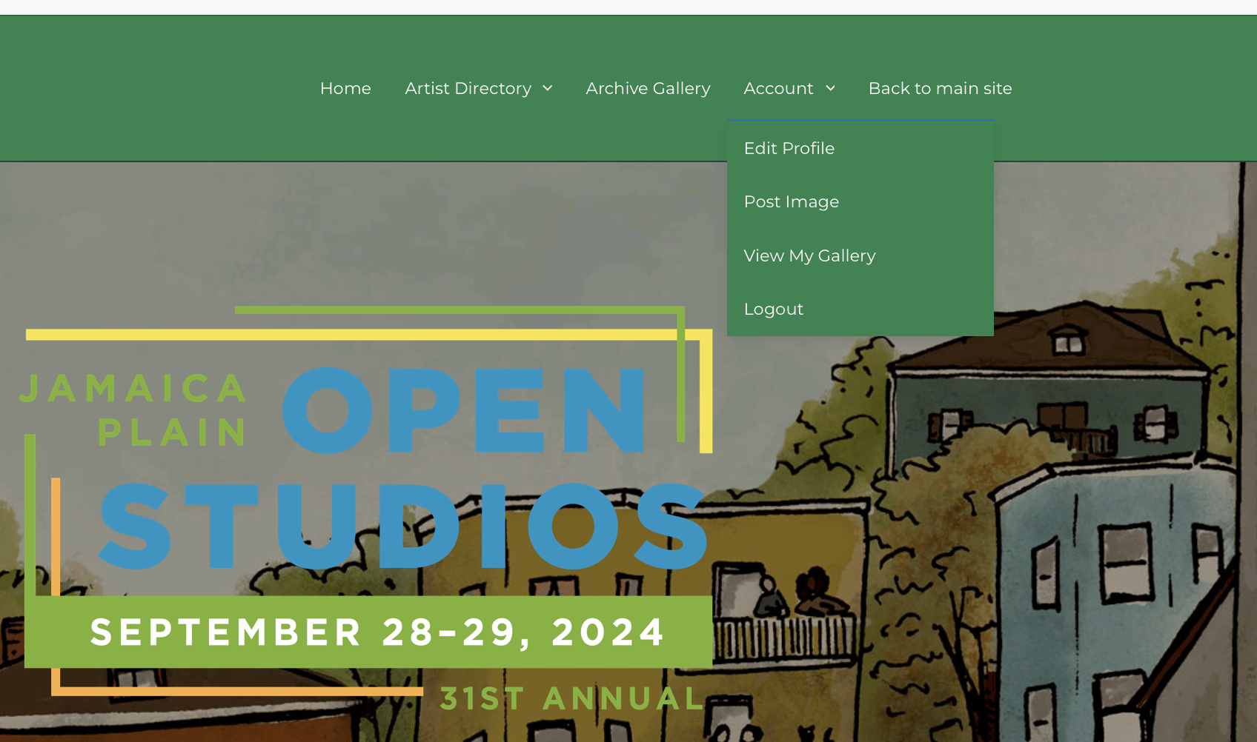
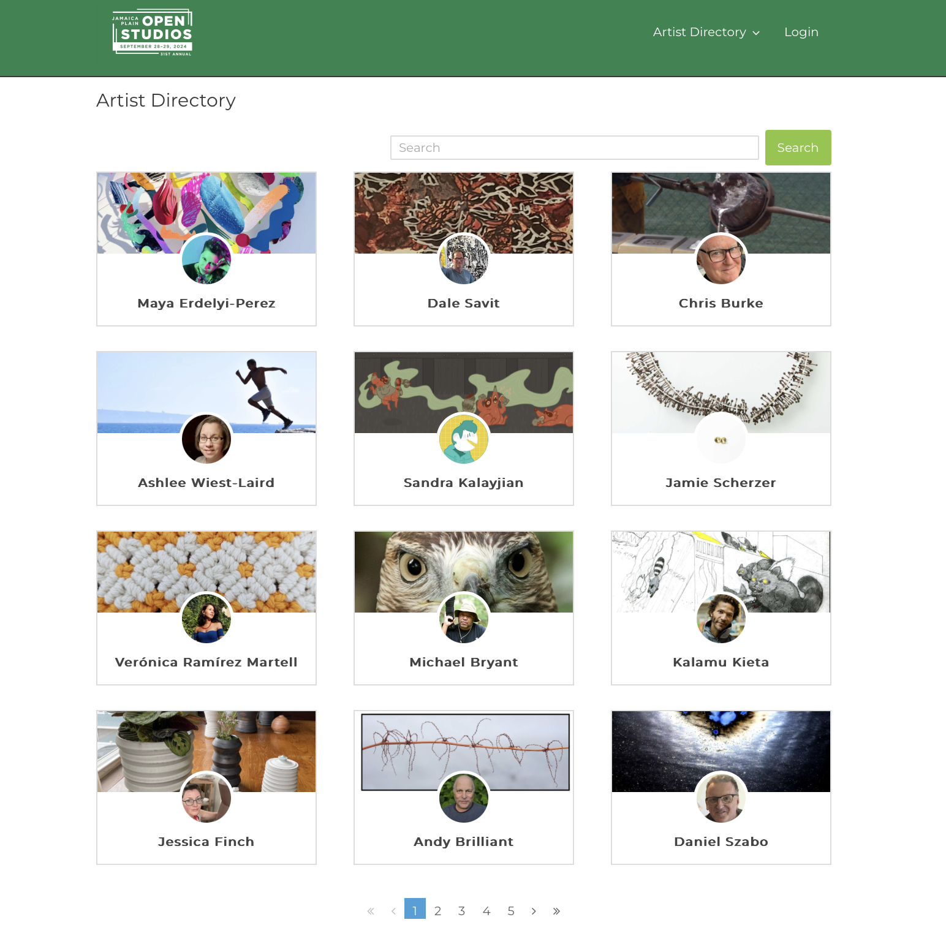
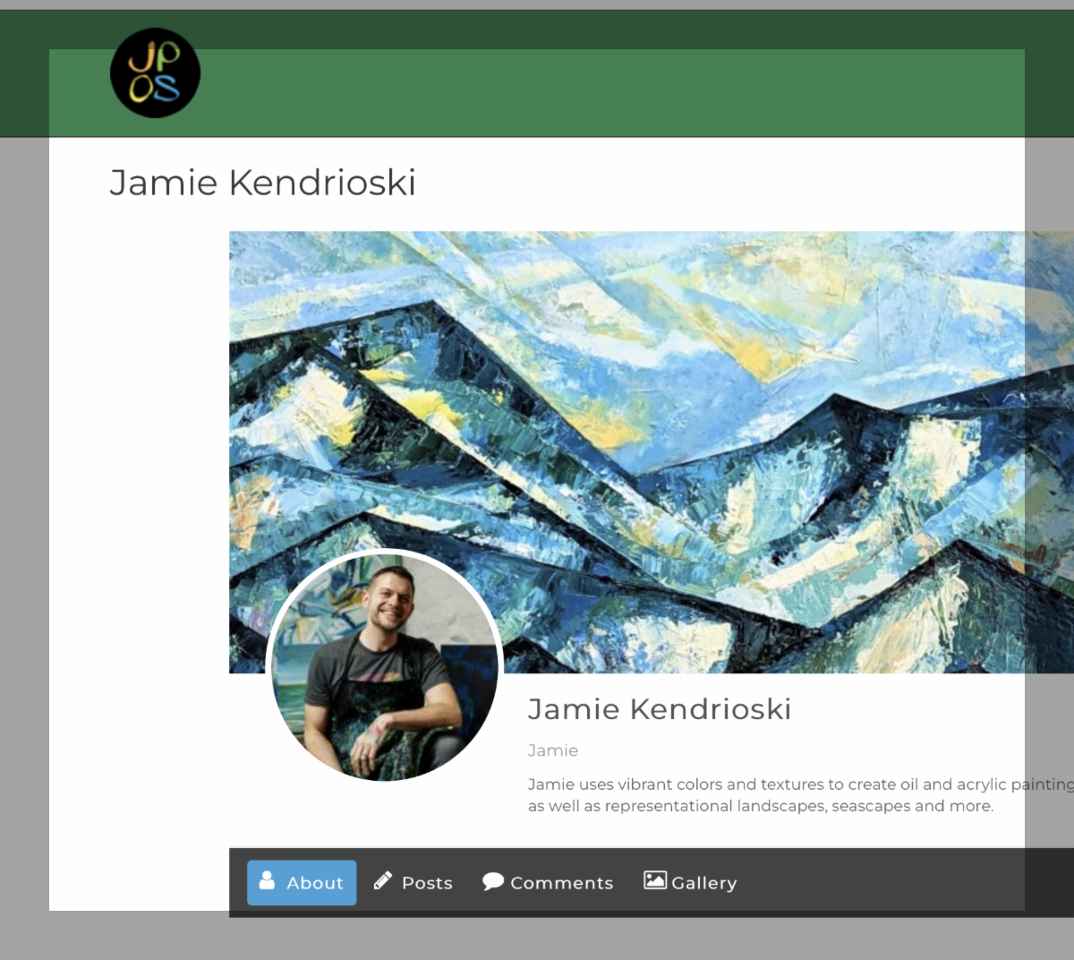
Artist Gallery, Website
Artist Gallery Profiles: Prompt to set up a profile when you receive registration confirmation, also under your account tab on the registration site.

Slide 9
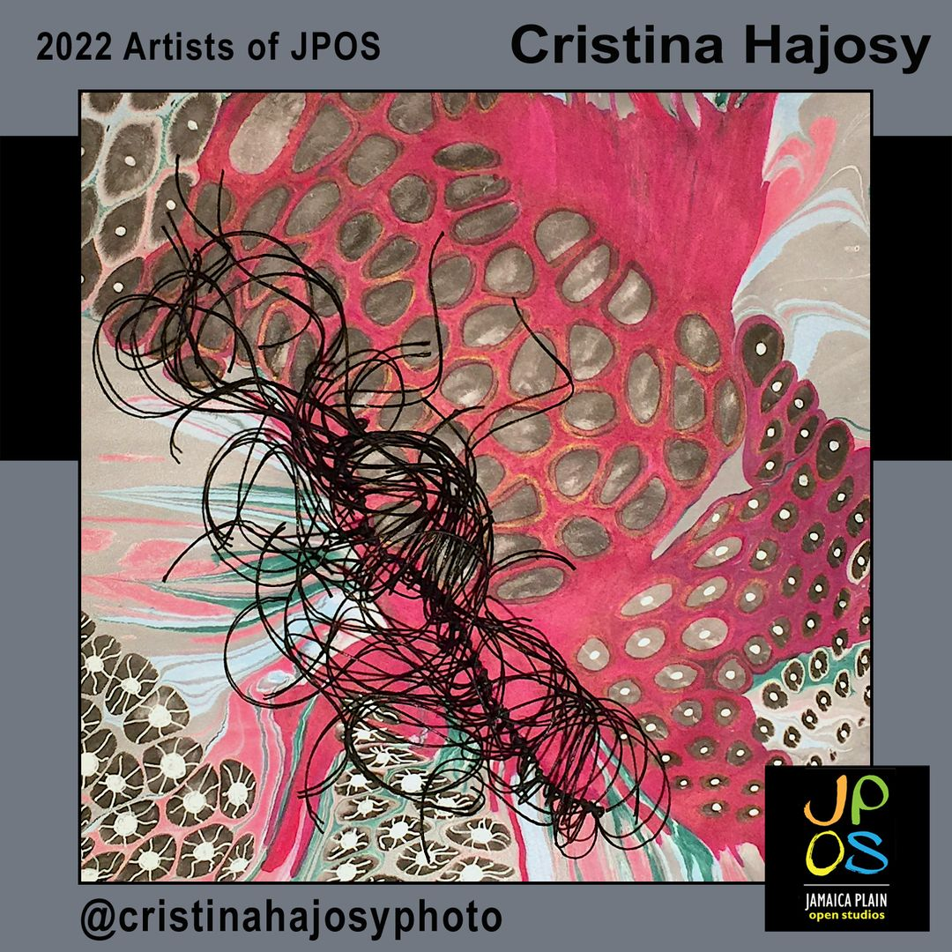
Artists of JPOS Campaign
Submission link in Registration confirmation email and on website

Slide 10
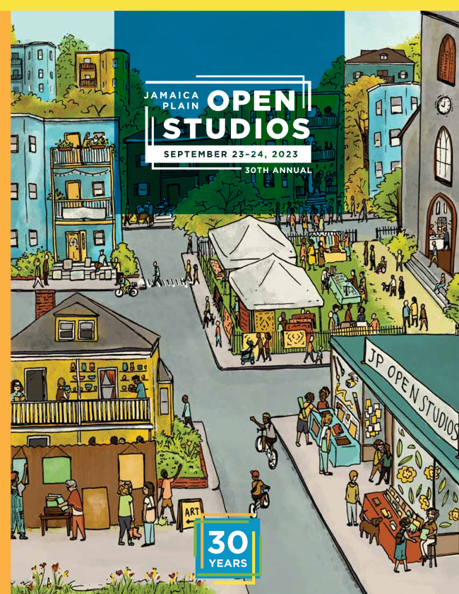
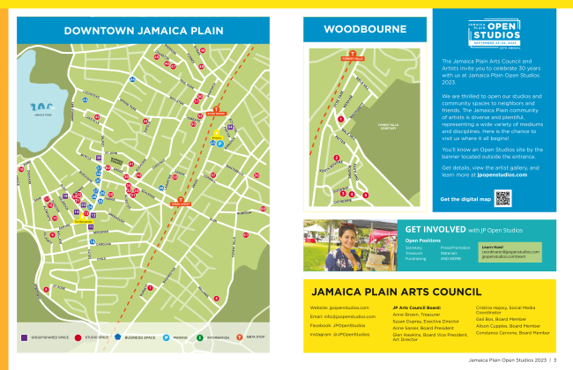
JPOS Map(s)
Printed and Digital
Artist listings: Name, Address, Medium

Slide 11
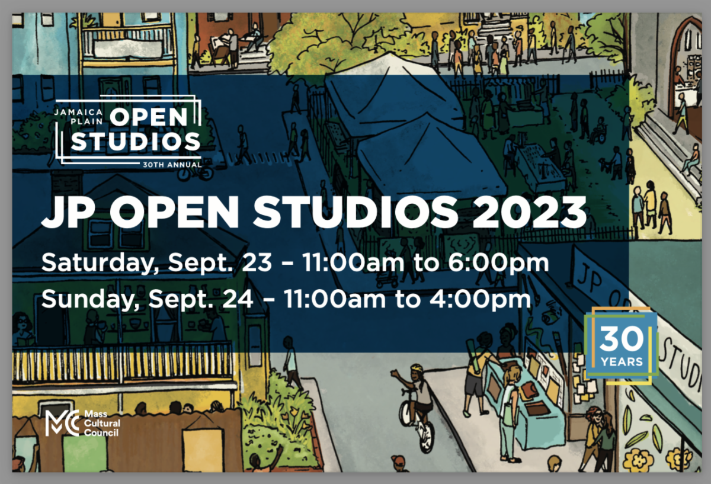
Banners, Yard Signs, Postcards, Social Media Templates, Name Tags

Slide 12
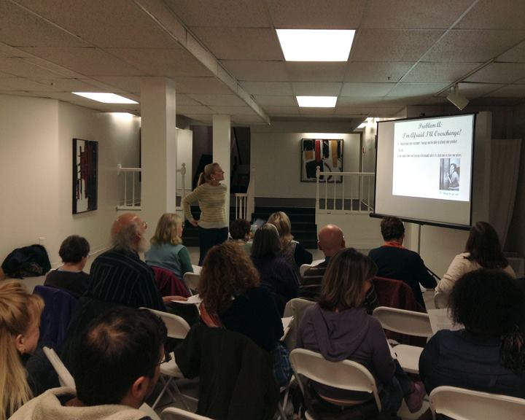
Free Workshops for JPOS Artists In person and virtual options
Making the Most of Open Studios
Accounting for Artists
Finding the Right Formula: How to Properly Price Your Products & Services

Slide 13
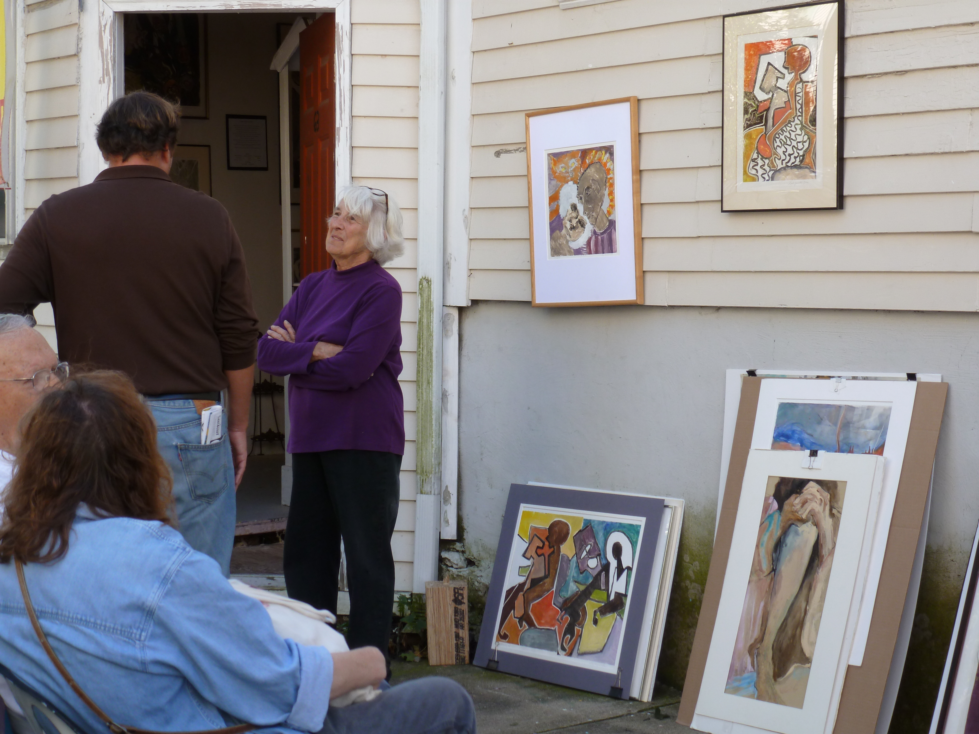
Artists Can Help JPOS Go Smoothly!
Come to materials distribution night on September 11th!
Put a yard sign in your yard
Hand out or mail postcards to your contacts
Hang posters in a business or community bulletin board near you
Self Promotion!
Mailing lists
Get together with neighboring artists; create signs, flyers, maps
Communicate any questions to your site coordinator (Group Sites) or to coordinator@jpopenstudios.com for private sites
Submit your materials to the Artists of JPOS campaign as early as possible
Review the Artist Guide (sent out after registration), JPOS emails and site coordinator e-mails to ensure you understand logistics, etc.
Use our hashtags and tag us on social media; #JPOpenStudios

Slide 14
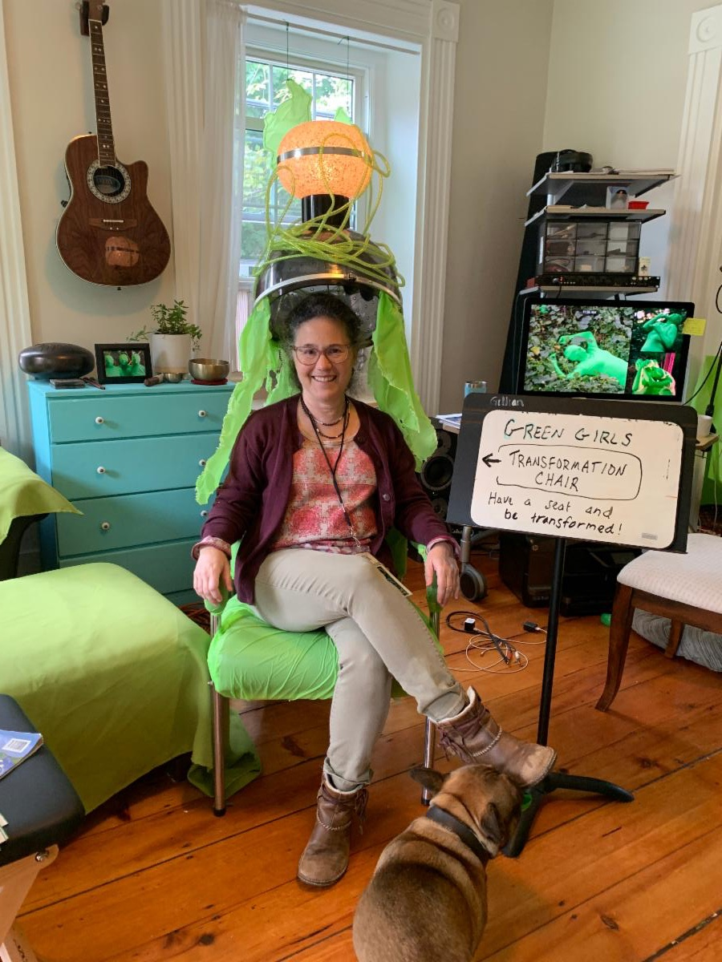
JPAC Volunteer Opportunities
We are in need of volunteers who can do:
Sponsor Solicitation
Website/Technical support
Map and Poster distribution (August/September) - 2+ hours
Banners and artist materials distribution (September) - 2+ hours
Information booth staffing Saturday 9/28 and Sunday 9/29 during event – 2/3 hour shifts
Social media marketing
creating regular posts in 3 areas:
Artists - May through September - 6-8 hours per month
Sponsors - July through September - 6-8 hours per month
Community - throughout the year - 2-4 hours per month
can be shared by different people

Slide 15
Questions
Jamaica Plain Open Studios 2024
Saturday and Sunday, September 28 and 29, 2024

